Slide 1
Jermyn Borough Council Meeting
11/21/2024

Slide 2
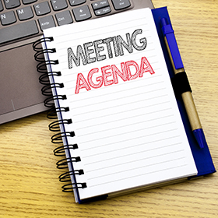
Meeting Agenda
NOVEMBER 21,2024
CALL TO ORDER
PLEDGE OF ALLEGIANCE
ROLL CALL
PREVIOUS MEETING MINUTES
TREASURER REPORT/BILLS PAYABLE
SECRETARY REPORT
CORRESPONDENCE
PUBLIC COMMENT
PROFESSIONAL REPORTS-POLICE, FIRE, SOLICITOR, ZONING, ENGINEER, TAX COLLECTOR, MAYOR
COMMITTEE REPORTS-SAFETY, PLANNING, FINANCE, SHADE TREE, REC, MS4, DPW
BUDGET ADVERTISEMENT
RESOLUTION 20-2024- LSA GRANT- RUSHBROOK CREEK PHASE 1
GRANT ADMINISTRATION AGREEMENT- LSA GRANT- RUSHBROOK CREEK PHASE 1
RESOLUTION 21-2024- PENNDOT MTF GRANT- CURB & SIDEWALK PROJECT
GRANT ADMINISTRATION AGREEMENT- PENNDOT MTF GRANT- CURB & SIDEWALK PROJECT
EXECUTIVE SESSION
POLICE CONTRACT FOR 2025
NEW BUSINESS

Slide 3
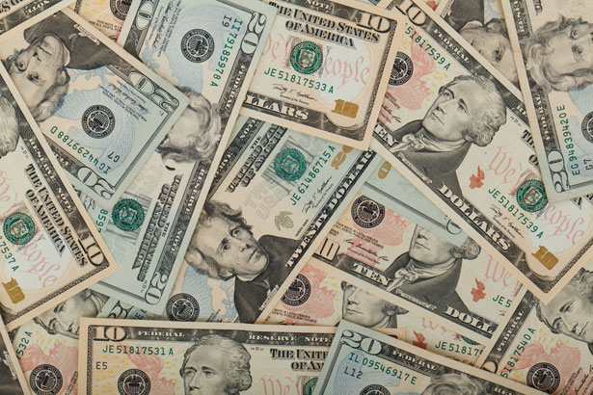
Treasurer’s report
11/21/2024
ASSETS
Checking/Savings
American Rescue Plan Fund 124,773.89
Capital Reserve - DPW 1,040.64
Capital Reserve - Police 6,244.82
Crime Watch Fund 222.69
General Fund - Community 79,541.58
General Fund - FNB 6,177.28
Holiday Lights Fund 300.59

Slide 4
Treasurer’s report
Investment - General Fund 1,112.07
Investment - Liquid Fuels 24,485.49
Investment - Paving Fund 1,123.65
Investment - Recycling 122.81
Investment - Refuse 175.12
Liquid Fuels - FNB 2,949.38
Petty Cash 196.50
Recreations Fund 27,281.70
Recycling - Community 5,821.60
Refuse Checking - FNB 128,461.50
Total Checking/Savings 410,031.31

Slide 5
Treasurer’s report
200000 · Accounts Payable 16,047.80
Long Term Debt 79,093.76

Slide 6
MS4 Minute
https://www.youtube.com/watch?v=sBhzpZD8i8s

Slide 7


